Slide 1

Schengen Visa Stats 2018
Project team members:
Farheen Zehra(PES2201800651)
Shivani Sweta(PES2201800369)
November 22,2019
1

Slide 2
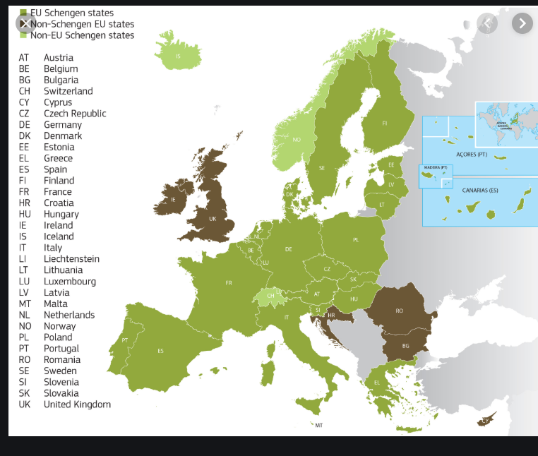
Schengen visa
A Schengen visa is a short stay visa allowing its holder to circulate in the Schengen area. The Schengen area covers 26 countries ("Schengen States") without border controls between them.

Slide 3
Columns
Schengen State
Country where consulate is located Consulate Country
Consulate City
Airport transit visas (ATVs) applied for
ATVs issued (including multiple)
Multiple ATVs issued
ATVs not issued
Not issued rate for ATVs
Uniform visas applied for
Total uniform visas issued (including MEV)
Multiple entry uniform visas (MEVs) issued
Share of MEVs on total number of uniform visas issued
Total LTVs issued Limited Territory Visa
Uniform visas not issued
Not issued rate for uniform visas
Total ATVs and uniform visas applied for
Total ATVs and uniform visas issued (including multiple ATVs, MEVs and LTVs)
Total ATVs and uniform visas not issued
Not issued rate for ATVs and uniform visas

Slide 4
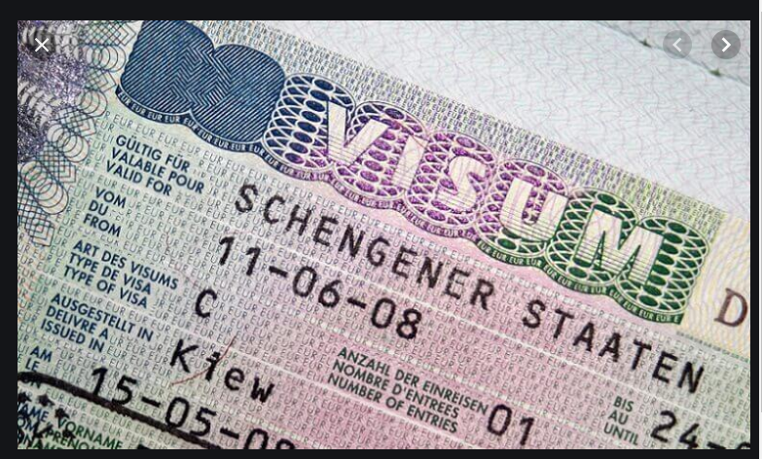
Airport transit visas (ATVs)
An Airport Transit Schengen Visa is a permit designated for travellers that have to change flights at a Schengen airport. It enables them to stop and wait in the international transit area of a Schengen airport for their flight to their destination country.
Uniform visas
Uniform Schengen Visas (USV) The Uniform Schengen Visa stands for a permit of one of the Schengen Area Member Countries to transit or reside in the desired territory for a certain period of time up to the maximum of 90 days.

Slide 5

Schengen Visa Stats 2018
Description of the dataset
Dataset: Schengen Visa Stats
ROWS | COLS | Categorical Columns | Numerical Columns | Missing Values
1913 | 19 | 3 | 16 | 19%
November 27, 2019
5

Slide 6
Schengen Visa Stats 2018
Data Cleaning:
This is the first step in a data science workflow.
There are no missing categorical columns in the dataset.
The NaNs for numerical columns is replaced with the average of the columns.
The rows where data is missing for all 19 columns are dropped.
The rows where inferences is made about the dataset is also dropped.
The column values which have commas(Ex. 1,197) is converted into float(Ex. 1197.0) and replaced accordingly.
November 23,2019
6

Slide 7
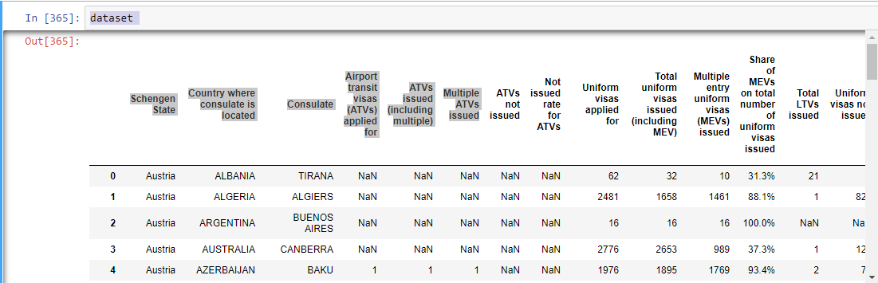
The percentage values are converted into the decimal form and the NaNs for these columns are replaced with the means of the converted decimal values.
Schengen Visa Stats 2018
Before cleaning:
November 23,2019
Introduction to Data Science Section: A sec

Slide 8
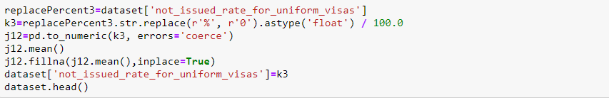
Schengen Visa Stats 2018
Replacing with Mean:
Converting Percent to Decimal and replacing with Mean:
November 23,2019
8

Slide 9
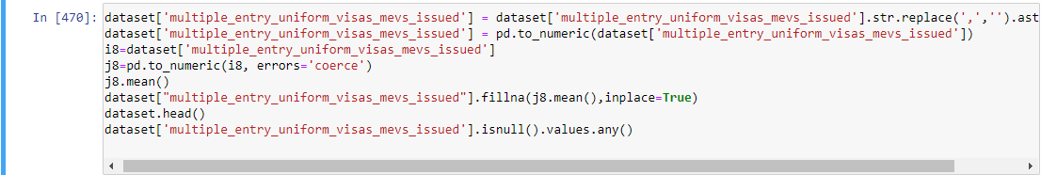
Schengen Visa Stats 2018
Converting values with comma to float and replacing the mean:
November 23,2019
9

Slide 10
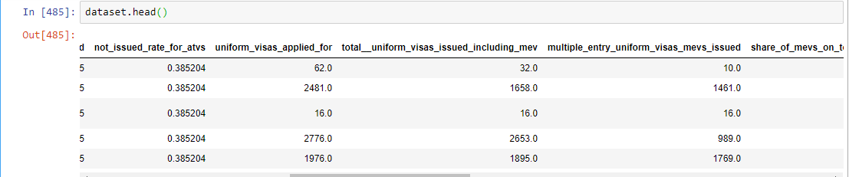

After Cleaning:
Schengen Visa Stats 2018
No null values in the dataset:

Slide 11
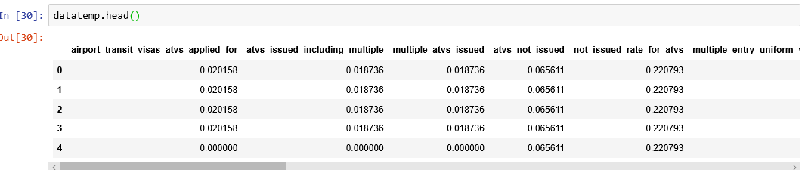
Schengen Visa Stats 2018
3. Normalization and Standardization:
The goal of normalization is to change the values of the numeric columns in the dataset
To a common scale, without distorting differences in the ranges of the values
Rescales the values into a range of [0,1].
November 27, 2019
11

Slide 12
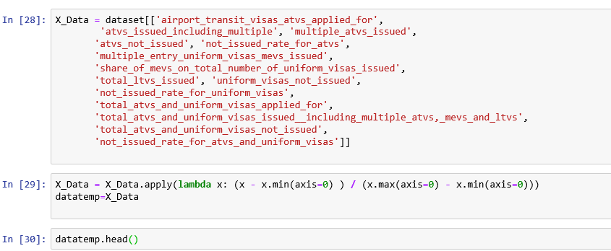
3. Normalization and Standardization:
Min-max scaling is done using lambda function
23/11/19
Introduction to Data Science Section: A sec
12
Notes:
12

Slide 13
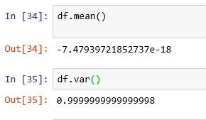
3. Normalization and Standardization:
Standardization typically means rescales data to have a mean of 0 and
unit variance.

Slide 14
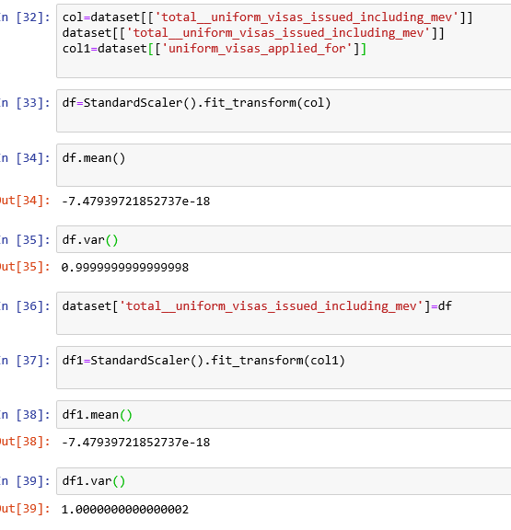
Standardization code:
Here standardization is done for two columns:

Slide 15
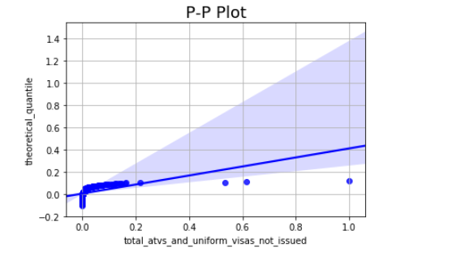
P-P Plot:
The normal probability plot shows a strongly non-linear pattern.
Therefore the data are skewed right.
The normal distribution is not a good model for these data.
Mean >Median for positive skewness.
23/11/19
Introduction to Data Science Section: A sec
15
Notes:
15

Slide 16
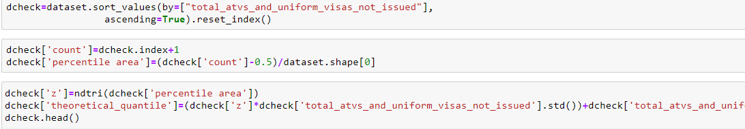
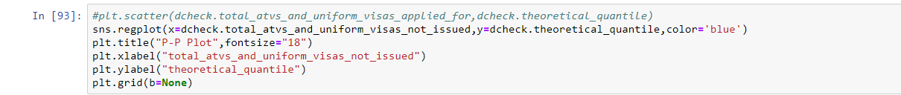
P-P Plot:

Slide 17
Schengen Visa Stats 2018
4. Graph visualization:
Bar Chart:
The bar chart is plotted for the countries which have applied for the visa (Y-axis) against the number of transit visas applied (X-axis) for the respective cities
By visualising the graph, we can conclude that the highest demand for visa is from the city Havana.
People in cities like Havana, Algiers, Mumbai ,New Delhi are more interested in visiting European Countries.
November 27, 2019
17

Slide 18
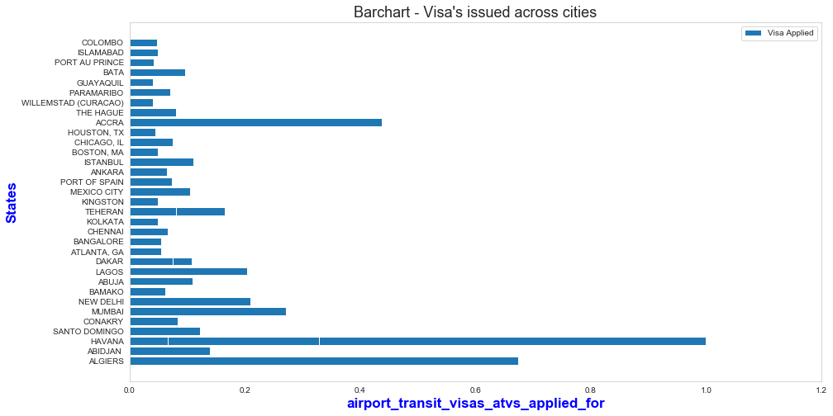
Schengen Visa Stats 2018
Bar Chart:
November 27, 2019
18

Slide 19
Schengen Visa Stats 2018
4. Graph visualization:
Box Plot:
The box plot is plotted for the rate at which uniform visas is not issued.
The plot obtained is negatively skewed.
Therefore data is more condensed(not spread out) near the upper quartile.
Visa is rejected for a less number of people.
The outliers indicate the rate at which the visas are not issued is exceptionally higher than the normal rate.
We can also conclude that the rejection rate of the visas is higher.
November 27, 2019
19

Slide 20
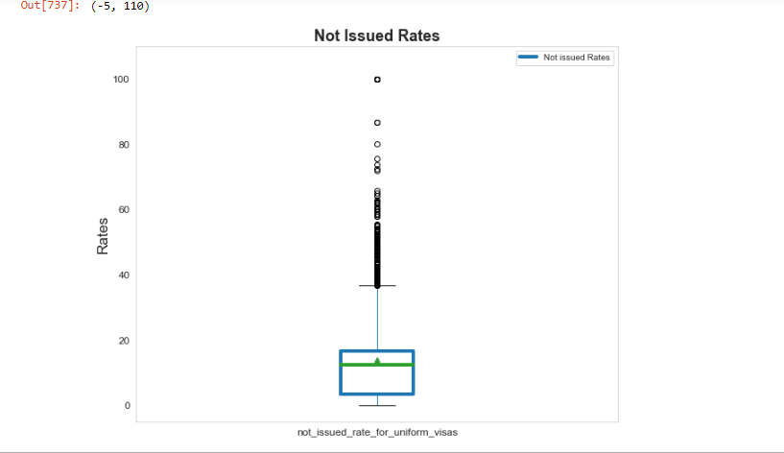
Schengen Visa Stats 2018
Box Plot:
November 27, 2019
20

Slide 21
Schengen Visa Stats 2018
Stem and Leaf Plot:
Stem and leaf plot is used for presenting quantitative data in a graphical format,
similar to a histogram, to assist in visualizing the shape of a distribution.
Typically, the leaf contains the last digit of the number and the stem contains all
of the other digits.
The stem and leaf plot essentially provides the same information as a histogram, with a added benefit that individual data points can be recovered from the plot.
The stem and leaf plot shows the distribution of multiple entry and uniform visas issued for various countries.
It is therefore not a good method for a large number of data points.
21

Slide 22
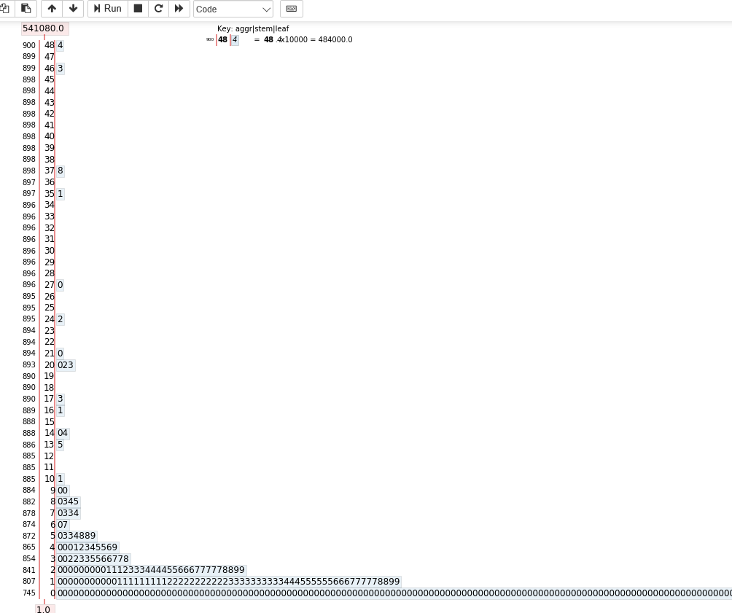
4. Graph visualization:
22/11/19
Introduction to Data Science Section: Asec
22
Notes:
22

Slide 23
Schengen Visa Stats 2018
Scatter Plot:
An animation frame is used to visualise how the not issued rate for airport transit visas and uniform visas vary for different countries who have applied for different Schengen states.
We can therefore visualise the rejection rates for the countries who have applied to different Schegen states.
It can also visualise the summary of the relationship between not issued rate and visas issued for all the Schengen states.
23

Slide 24
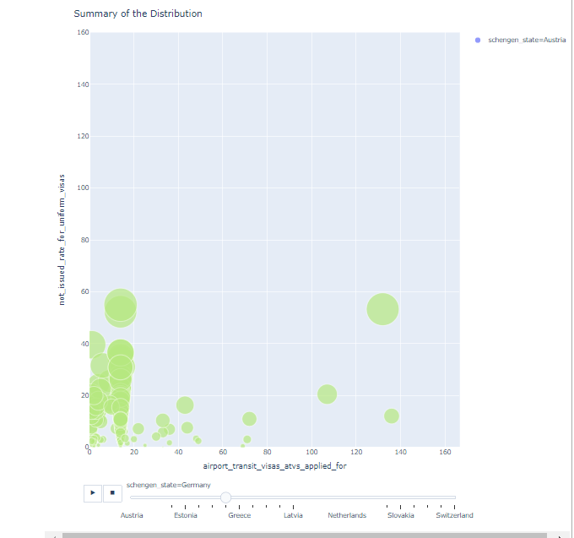
Schengen Visa Stats 2018
Scatter Plot:

Slide 25

Scatter Plot:

Slide 26
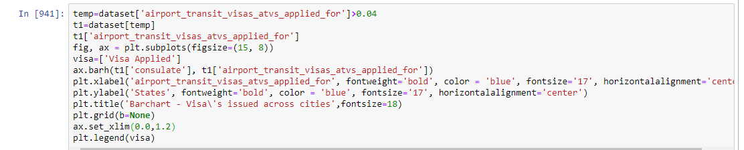
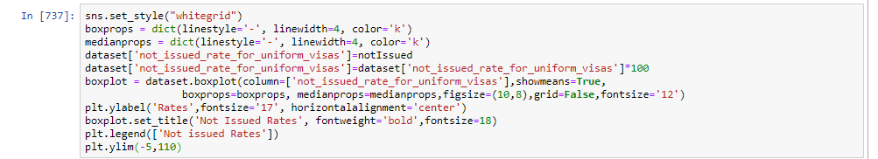
Schengen Visa Stats 2018
Bar Chart:
Box Plot:
November 27, 2019
26

Slide 27
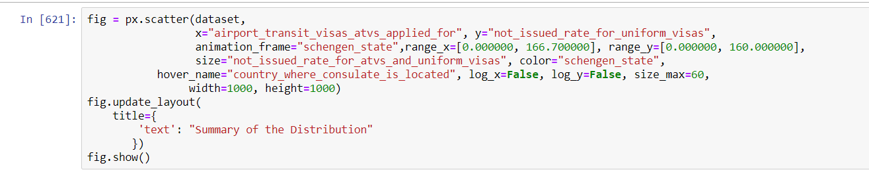
Schengen Visa Stats 2018
Stem and Leaf Plot:
Scatter Plot:
November 27, 2019
27

Slide 28
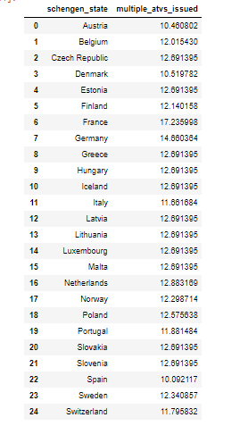
Schengen Visa Stats 2018
5. Hypothesis Testing:
H0: μ <= 12.48.
H1: μ > 12.48
n: 175
x’: 17.235998
November 27, 2019
28

Slide 29
Schengen Visa Stats 2018
5. Hypothesis Testing:
Hypothesis testing is used to infer the result of a hypothesis performed on sample data from a larger population.
Null Hypothesis: The average number of people who have applied for a visa to France will be less than or equal to 12.48.
Alternate hypothesis: We assume that the average number of people who have applied for a visa to 175 cities of France in a year will be greater than 12.48.
This is therefore a one-tailed test.
The average number of people who have applied for a visa to France is approximately 17.235998.(X bar)
November 27, 2019
29

Slide 30
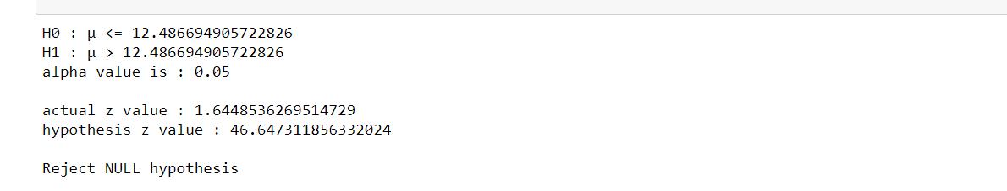
Schengen Visa Stats 2018
5. Hypothesis Testing:
By Z-test statistics ,we reject the null hypothesis.
Therefore our assumption is correct; the average number of people who have applied for a visa to France in a year will be greater than 12.48.
November 27, 2019
30

Slide 31
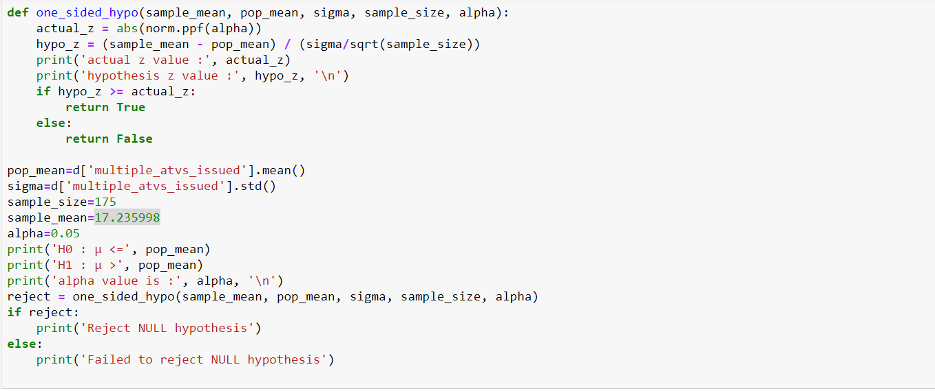
Schengen Visa Stats 2018
Hypothesis Testing:
November 27, 2019
31

Slide 32
Schengen Visa Stats 2018
6. Correlation:
The statistical relation between two variables is called correlation.
Correlation is useful in data analysis and modelling.
Correlation could be:
Positive correlation: Both variables change in same direction.
Negative correlation: Variables change in opposite direction.
Neutral correlation: No relationship in the change of the variables.
27-11-2019
Introduction to Data Science Section: A/D sec
32
Notes:
32

Slide 33

Schengen Visa Stats 2018
6. Correlation:
The sign of the correlation coefficient indicates the direction of the relationship.
Correlations above 0.4 is considered as moderate correlation. Between 0.2 and 0.4 is considered as weak correlation.
Here the correlation between multiple visas issued and visas not issued is weak.

Slide 34
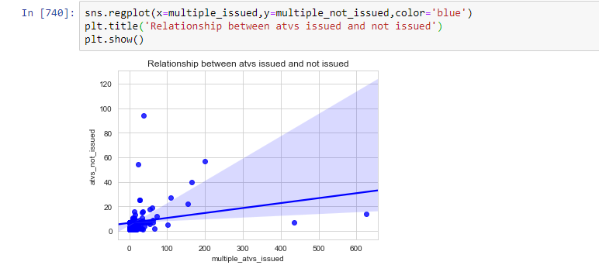
Schengen Visa Stats 2018
6. Correlation:

Slide 35
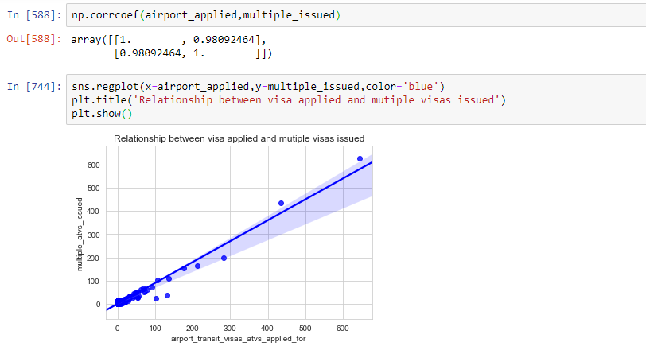
Schengen Visa Stats 2018
6. Correlation:
A third variable visas applied is tested to check if it is related with either multiple visas issued or visas not issued.
A strong correlation can be obtained between airport visas applied and multiple visas issued.

Slide 36
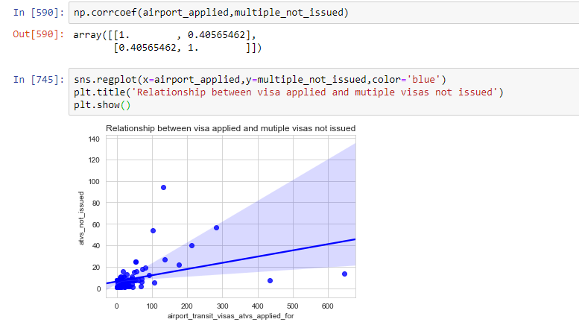
Schengen Visa Stats 2018
6. Correlation:
A moderate correlation can be obtained between airport visas applied and multiple visas not issued.

Slide 37
Schengen Visa Stats 2018
6. Correlation:
Thus the third variable is tested to check if it is correlated with multiple visas issued and multiple visas not issued.
A strong correlation is found for only multiple visas issued. Therefore it is not a confounding variable and thus does not lead to incorrect rejection of null hypothesis.

Slide 38
Schengen Visa Stats 2018
Thank you
November 27, 2019
38

